Slide 1
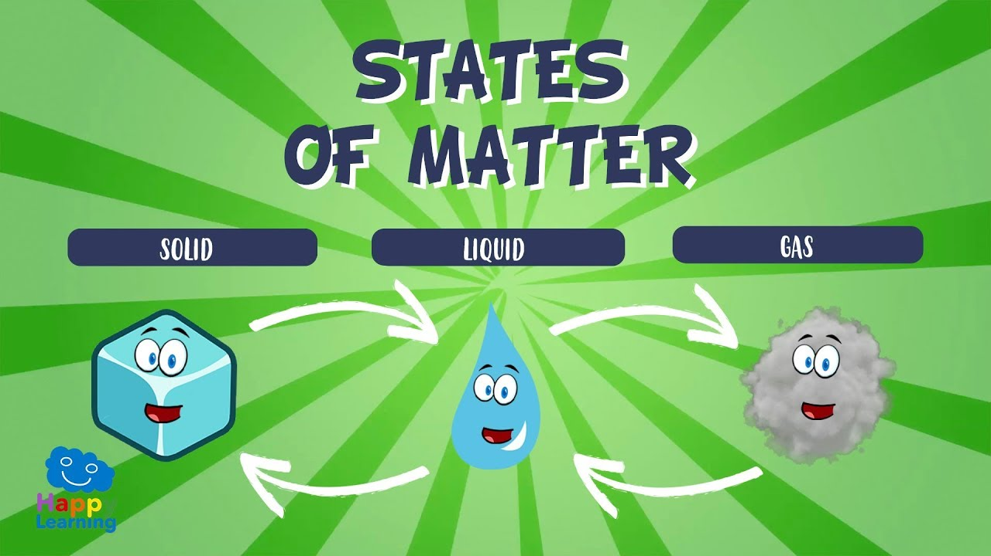
Science Grade 4
State of Matter
HIBA MOHAMED

Slide 2
Topics Covered
1- what is matter
2-state of matter
3-solid
4-liquid
5- gas
6-summary

Slide 3
learning Objectives
By the end of the lesson the student will be able to
Define the matter
Identify different phases of matter in the things around us.
identify the phases of matter (solid ,liquid ,gas ).
Identify the proprieties of the different phase of matter

Slide 4
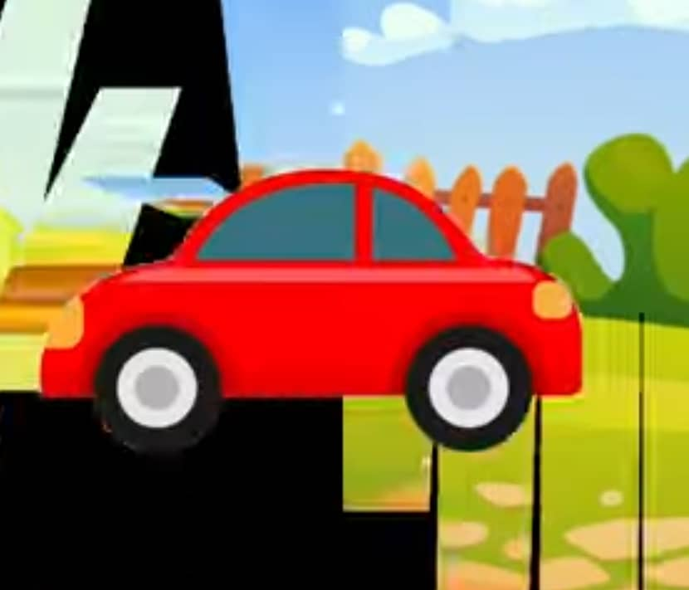
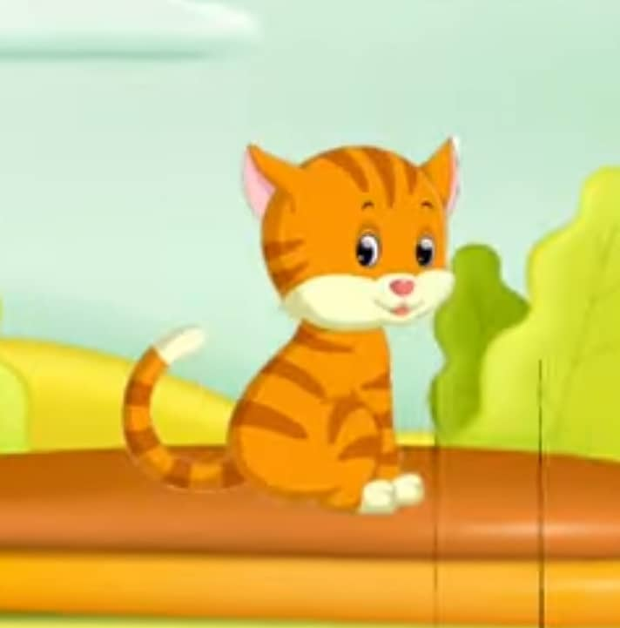
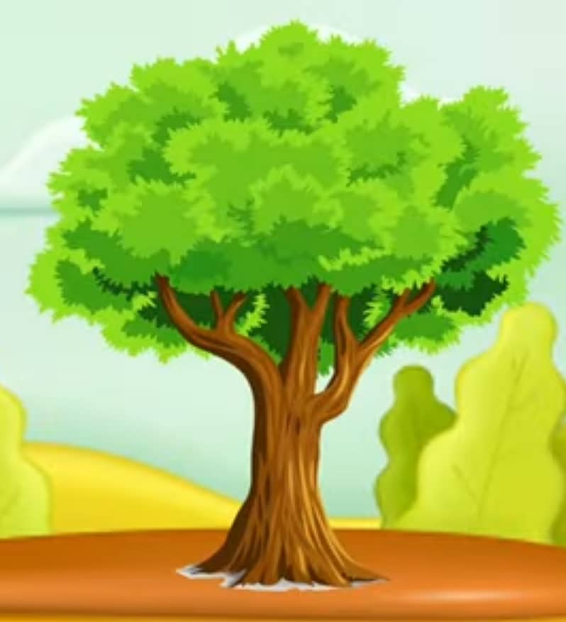
What is the matter
Every thinks in our universe is mad of matter .whether in the earth, up into sky or in our own home ,
Every things that we see around us is matter

Slide 5
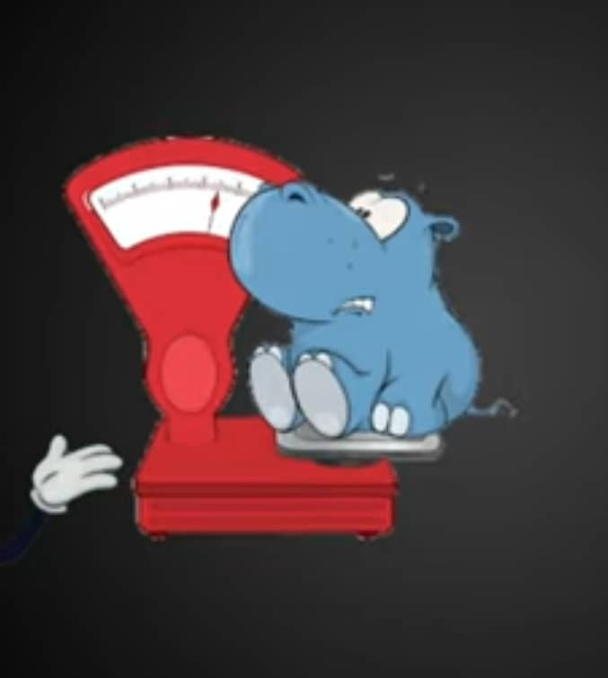
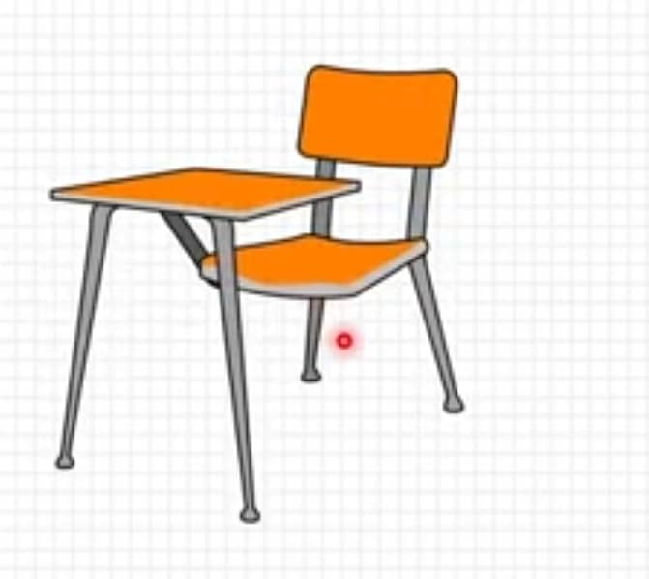

Matter
Matter is anything that has weight and takes up spac

Slide 6

Matter
the matter is mad up of very tiny particles called Molecules

Slide 7

Activity 1 :
Mention Three Examples Of Matter Around You

Slide 8
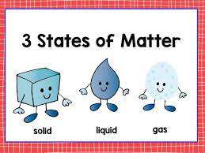

Slide 9
State of Matter
matter
Solid

Slide 10
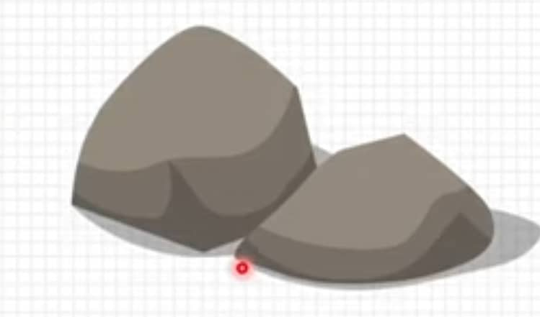

Solids
Solid are usually hard and have fixed shape and volume.

Slide 11
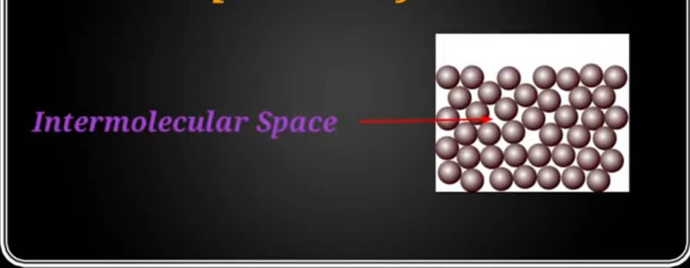
Solids
In solids ,molecules are closely packed to each other .
There is no space between molecules to move around
That is why solid have affixed shape

Slide 12
Properties of solid
Hard
Solid has a fixed shape
solid has a fixed volume

Slide 13
State of Matter
matter
Solid
liquid

Slide 14
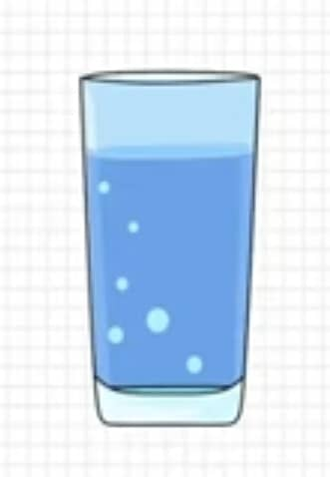
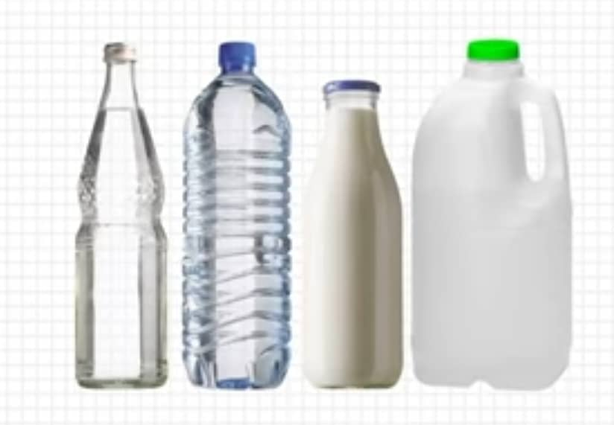
Liquids
Liquid have definite volume
but not fixed shape

Slide 15
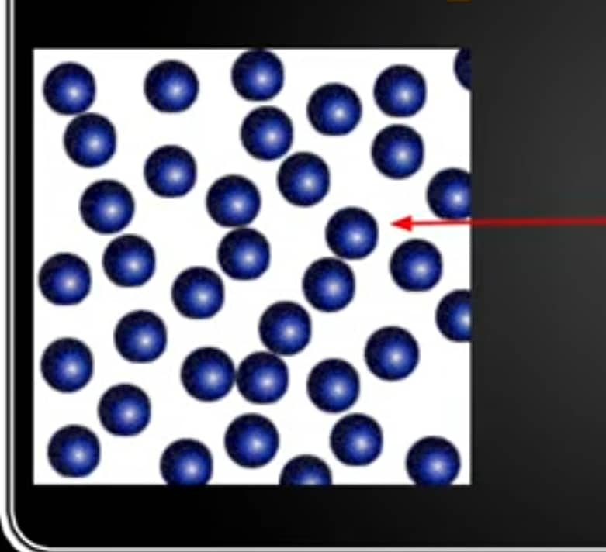
Liquids
In liquids ,molecules are not very closely packed to each other.
There is space between molecules to move around .
That is why liquid takes different shapes

Slide 16
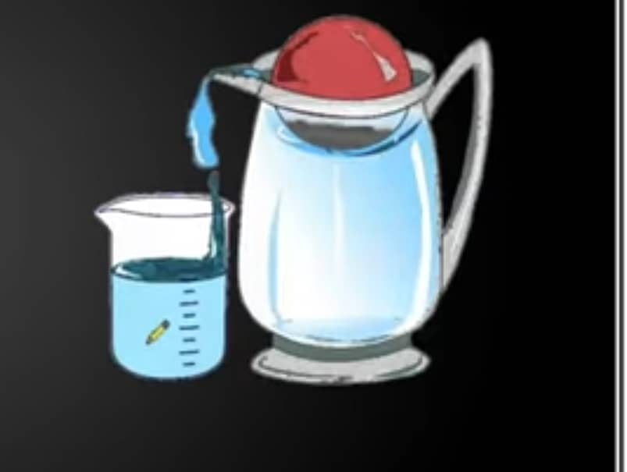
Properties of liquid
Not Hard
Liquid has no fixed shape
Liquid has a fixed volume

Slide 17
State of Matter
matter
Solid
liquid
Gas

Slide 18
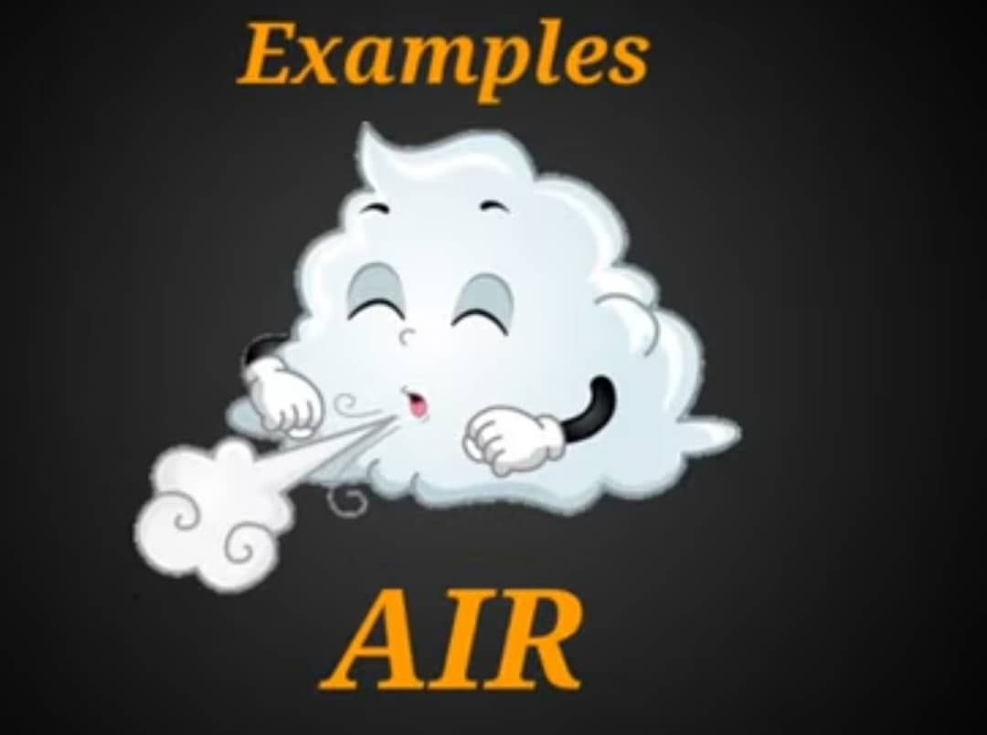
Gas
Gases have no definite volume and no fixed shape.

Slide 19
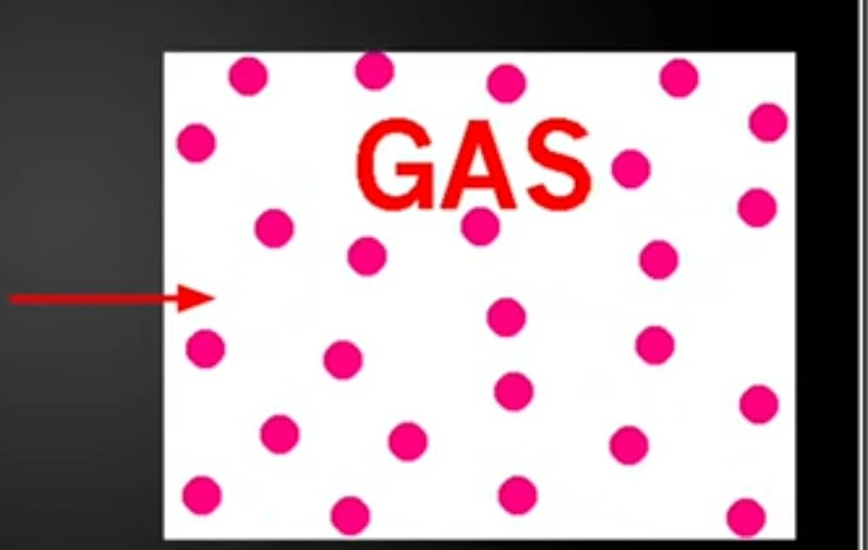
Gas
In gases ,molecules are very loosely packed to each other
There is space between molecules to move around
Molecules can move quickly in all direction .

Slide 20
Properties of gas
Not Hard
Gas has a unfixed shape
Gas has a unfixed volume

Slide 21
Activity 2: see the picture and figure out solid ,liquid or gas

Slide 22
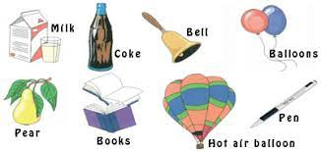

Slide 23
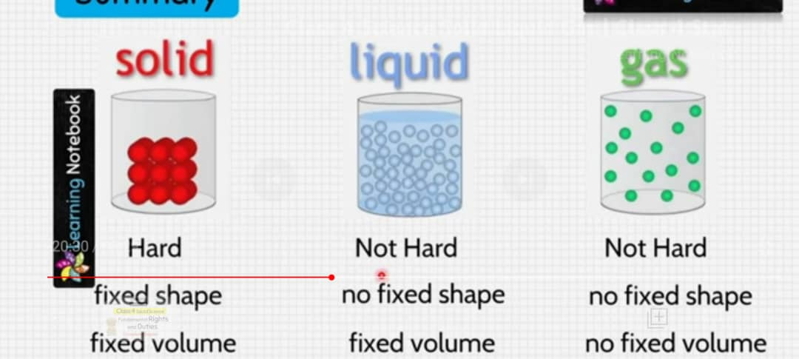
Summary : what you have learnt

Slide 24
Thank you

